Slide 1
TOWN OF ORCHARD PARK
BRUSH MOUNTAIN
COMMUNITY ACTIVITY CENTER
Public Presentations
September 4th & 5th, 2018

Slide 2
CONTEXT. The over 65 and under 18
populations have been on the rise in recent years, causing overcrowding at the senior center and within the existing recreation programs.
This growth is projected to continue for the next several decades.

Slide 3
In 2009 the Town and their consultants produced a report titled “Master Plan for Improvements at Brush Mountain Park”. This plan established Park improvement goals, and identified a need and location for a proposed community center.
Two-year process; $125,000 (Peter J. Schmitt).
Original intent was to have a community referendum > never occurred.

Slide 4
In 2011 the Town Engineering Department, as directed, revisited the center and the previous report. They created an interim program and building layout, however it was not pursued by the Town.

Slide 5
2015
Senior Services Task Force
Recreation Commission
Community Activity Center Task Force
2016
April – Architectural Report & Proposal
July – scientific poll of community
November – referendum

Slide 6
Core area which is centrally located and inclusive of an entry/reception area, shared office space for various departments and programs, a conference room, staff lounge, office storage, locker rooms and a family changing room.

Slide 7
Community center for communal activities for children, young adults and families. Included will be a multi-purpose flexible activity room (e.g., aerobics, dance, yoga, etc.), a flexible fitness or portable class room area, a flexible game and activities room (e.g., pool, ping pong, Wii, card tables, etc.), and a flexible and secure child watch space for toddlers.

Slide 8
Senior center inclusive of multi-purpose classrooms, a large, divisible and flexible multi-purpose room for such things as dining and various activities (also usable for community events such as weddings, movies, etc.), an arts and crafts room, library, wellness and medical screening rooms, a teaching kitchen and a billiards room.

Slide 9
Gym with a multi-activity floor striped for multiple sports (basketball, volleyball, pickle ball, etc.) with roll-up vertical nets to subdivide the gym for concurrent use by multiple users.

Slide 10
ANNUALIZED OPERATIONS & MANAGEMENT
Additional Costs | Additional Revenues | Capital & Maintenance Savings | Net
($148,600) | $100,000 | $75,000 | $26,400
Note: Solar could net future annual savings of $100,000 to town.

Slide 11
FUNDING
Capital campaign goal of $1,500,000 to $2,000,000.
Sale of the Town’s current Senior Center would produce between $500,000-$600,000.

Slide 12
BONDING
Anticipated $14,000,000 project build.
Current interest rate = 2.115%.
✓ Median valued home = $220,500 full /
$121, 275 assessed

Slide 13
Annual – Full Valuation | $220,500 @ 2.115% | $220,500 @ 2.75% | $220,500 @ 3.75%
$12,000,000 | $42.19 | $45.93 | $52.17
$14,000,000 | $49.22 | $53.59 | $60.86
$16,000,000 | $56.25 | $61.24 | $69.56

Slide 14
Month – Full Valuation | $220,500 @ 2.115% | $220,500 @ 2.75% | $220,500 @ 3.75%
$12,000,000 | $3.52 | $3.83 | $4.35
$14,000,000 | $4.10 | $4.47 | $5.07
$16,000,000 | $4.69 | $5.10 | $5.80

Slide 15
Post-referendum steering committee
Wendle Architects & Engineering
Town Board
Town Engineering Department
(Seniors & Recreation)
Various issues, obstructions, problems > adjustments & solutions
Federal & State standards > $millions additional
Value Engineering (integrity of project)
Contract bids

Slide 16
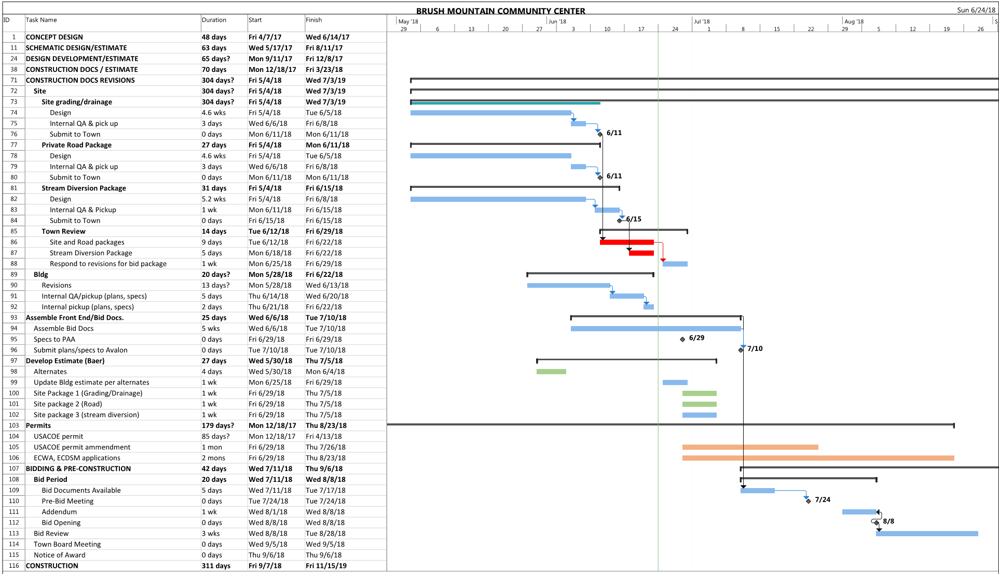

Slide 17
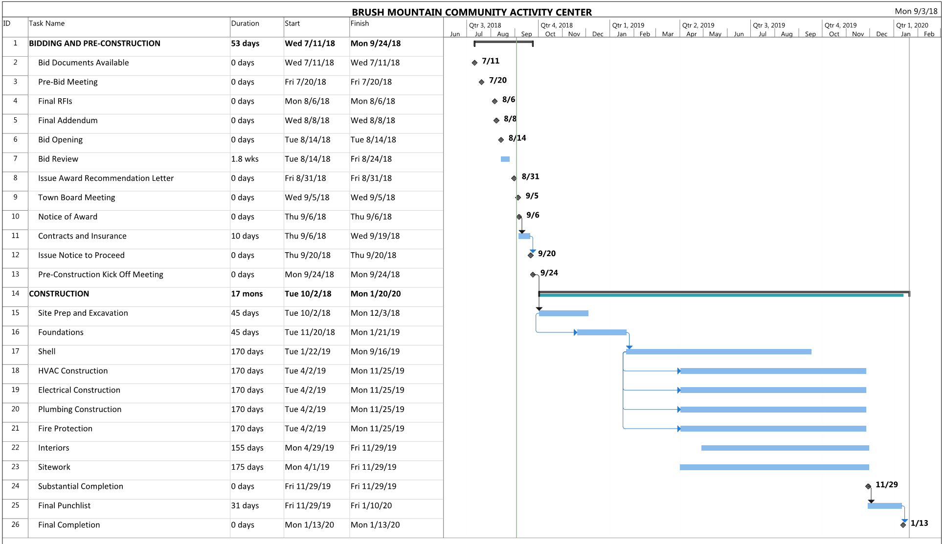

Slide 18
SCHEDULE
1
PROGRAMMING + CONCEPT DESIGN (COMPLETED)
2
SCHEMATIC DESIGN (COMPLETED)
3
DESIGN DEVELOPMENT (COMPLETED)
4
CONSTRUCTION DOCUMENTS – (COMPLETED)
5
BIDDING + PRE-CONSTRUCTION – (IN PROGRESS)
6
CONSTRUCTION START – OCTOBER 2018
7
CONSTRUCTION COMPLETION – WINTER 2020
8
BUILDING OCCUPANCY– SPRING 2020
Notes:
.

Slide 19
2018 Project Alternates (in order of priority)
ACCEPTED ALTERNATES
Alternate No. 1 Delete Porte Cochere
Alternate No. 2 Delete Millwork (Approximately 50%) Beyond the Classroom Millwork
Alternate No. 3 Replace Standing Seam Roof With Asphalt Shingles
Alternate No. 11 Cost to replace use of Structural Fill below site area only with prepared, tested, compacted and approved on-site soils from on-site soil material stickpile noted on plan
UNACCEPTED ALTERNATES (prices held for 15 months)
Alternate No. 4 Add Gym Interior Fit Out
Alternate No. 5 Add Senior Fit Out
Alternate No. 6 Add Recreation Fit Out
Alternate No. 3 Add Standing Seam Roof
Alternate No. 7 Diesel Generator Alternate
Alternate No. 8 Add North Parking Lot (By Contractor)
Alternate No. 9 Add Locker Room Fit Out
Alternate No. 10 Add Restroom and Shower Fit Out

Slide 20
2018 Project Contract Award Summary
General: Javen Construction $ 12,095,328
HVAC: DV Brown $ 1,207,000
Electrical: IPL $ 1,739,100
Plumbing: Numarco $ 642,000
Fire Protection: WT Spaeder $ 177,500
2018 Total Project Contract Award (includes alternates) $ 15,860,928
Alternates to be Accepted
Alternates to be Accepted
Alternate 1
Delete Porte Cochere
Alternate 2
Delete Millwork (approx. 50%)
Alternate 3
Replace standing seam roof with Asphalt Shingles
Alternate 11
Cost to replace use of Structural Fill below site area only with prepared, tested, compacted and approved on-site soils from on-site soil material stockpile noted on plan
Missing Program Elements
Missing Program Elements
Alternate 4
Finishes for the Gym
Alternate 5
Finishes for three Sr. Classrooms
Alternate 6
Finishes for Fitness Area, Game Room, Interior Child Watch
Alternate 7
Generator
Alternate 9/10
Finishes for the restroom/locker area (to be finished when pool built)

Slide 21
2018 Project Budget Summary
Building (60,000 SF) + Site Contract Award $ 15,860,928
Owner Contingency @ 5% $ 900,000
Town Site Work/Utility Fees/Material Testing $ 1,000,000
Design Fees $ 1,585,000
Project Coordination Fees $ 888,240
2018 Total Project Budget $ 20,234,168

Slide 22
Town of Orchard Park Community Activity Center Estimated Expenses to Date (as of 8/31/18)

Slide 23
2019 If Build Only Senior + 50% of Shared Space
Building (25,000 SF) + Site + Fees Paid + Escalation $ 11,398,353
Owner Contingency @ 5% $ 609,161
Town Site Work/Utility Fees/Material Testing $ 1,000,000
Design Fees $ 617,396
Project Coordination Fees $ 752,476
2019 Total Project Budget $ 14,377,386
Missing Program Elements
Dance studio
Fitness area
Gym:
Pickleball
Large event space for ALL senior groups
Other athletics/classes
Policing office
Shared office space
Sr Director and Assistant director offices are in the sr area, BUT this removes opportunities for additional offices.
Reception/desk area shrinks
No conference room

Slide 24
2025 If Build Only Rec + 50% of Shared Space
Building (35,000 SF) + Site + Escalation $ 12,966,091
Owner Contingency @5% $ 730,674
Design Fees $ 842,791
Project Coordination Fees $ 804,491
2025 Total Project Budget $ 15,344,047
2019 Total Project Budget $ 14,377,386
Total $ 29,721,433
2018 Total Project Budget (full fit out) $ -23,601,168
Premium to Split Project $6,120,265

Slide 25
Town of Orchard Park Community Activity Center Potential Financing Sources (as of 8/31/18)

Slide 26
Government responsibilities
Rights
Taxes
Quality of life
Safety

Slide 27
POLITICAL PHILOSOPHY & RESPONSIBILITY
Elected to make decisions for the people.
- vs -
Elected to do the will of the people1
1. Inform > ascertain > execute

Slide 28
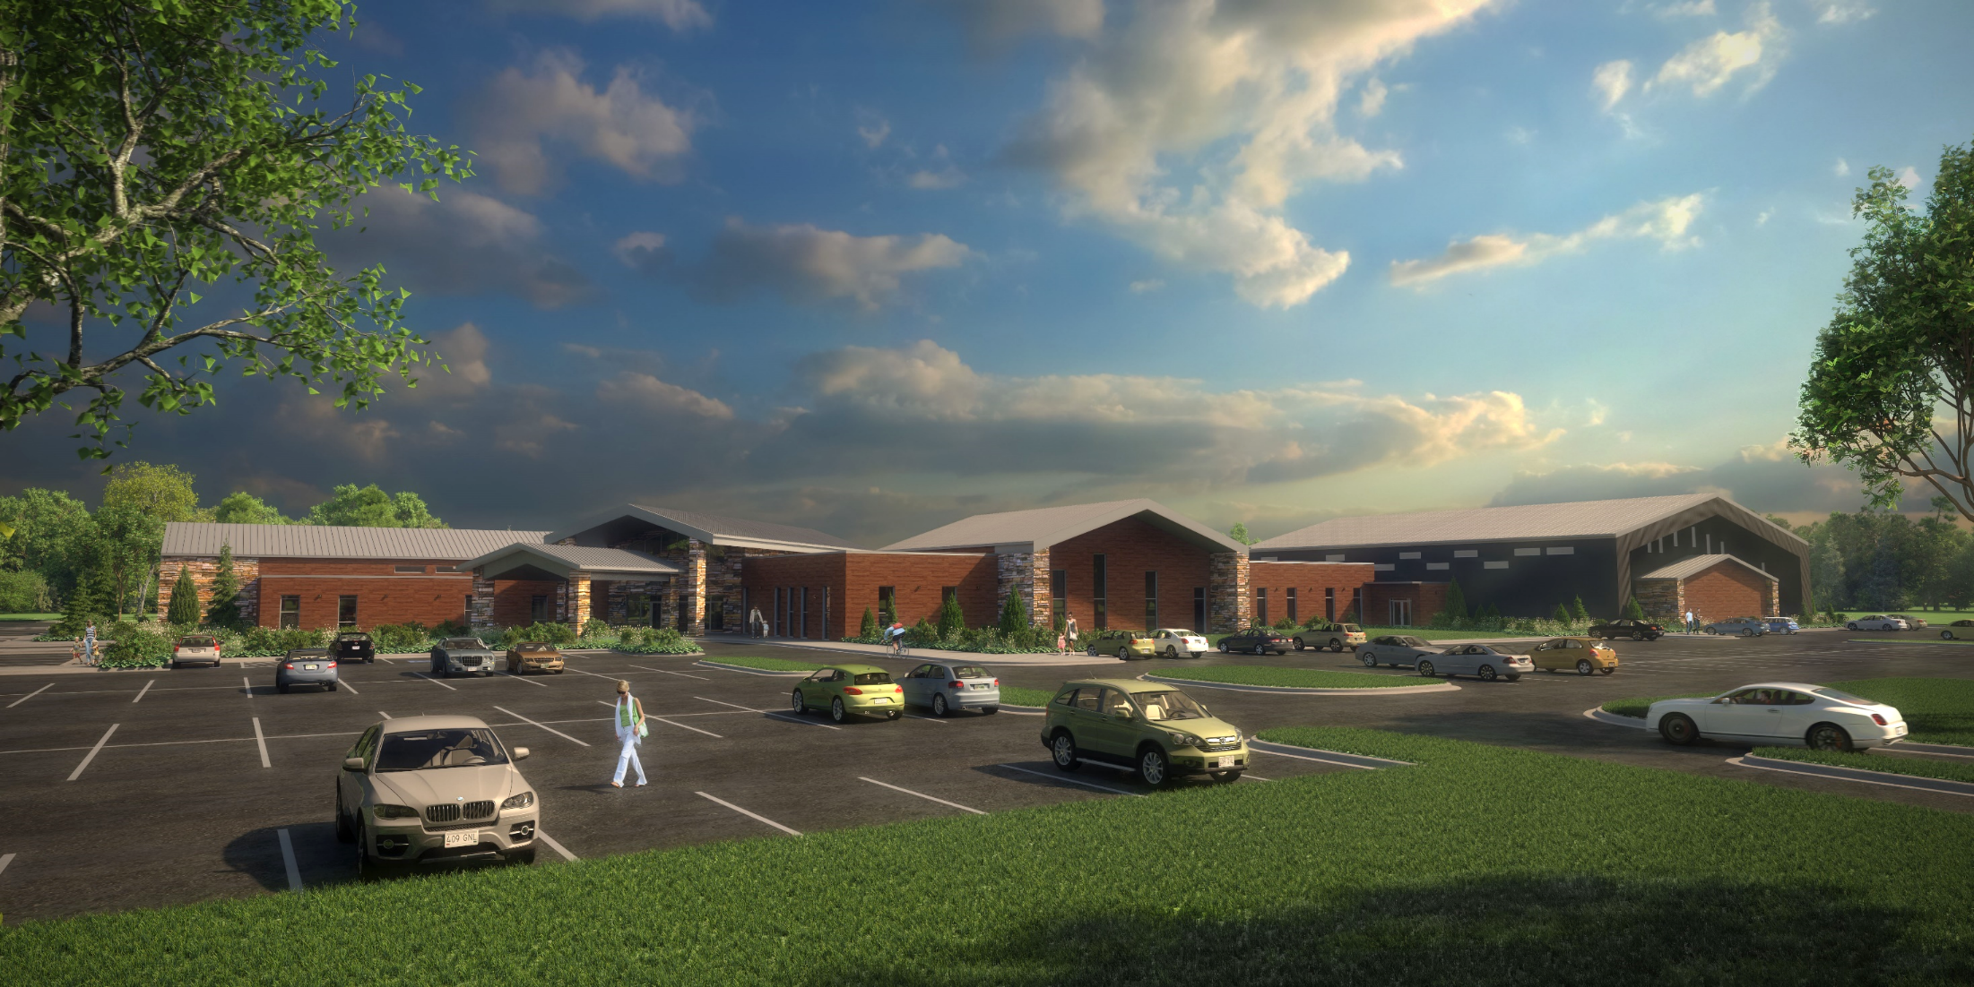

Slide 30
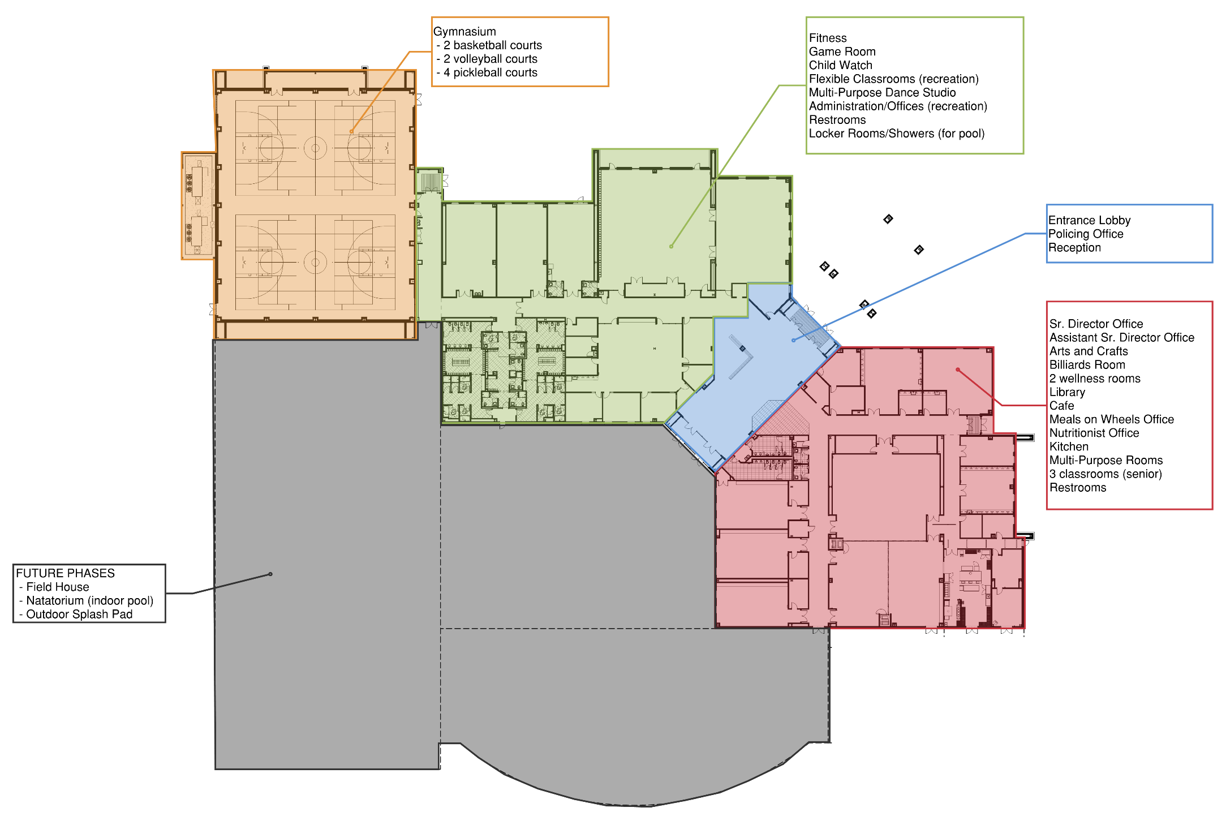

Slide 31
Web page updates (orchardparkny.org)
Quarterly:
September, December, March, June
Progress
Project timeline
Current estimate of cost(s) & any impact
Contracts

Slide 32
SUMMATIOn
Overwhelmingly approved by the community (Nov. 2016)
Long, thorough, collaborative process (first begun in 2007)
Already borrowed $16 million to take advantage of interest rates
No more borrowing
No drawing down from general reserves = healthy
Will not add anything we do not have the funding for
Keep the community informed

